Slide 1

AI-Powered Python in Excel
George Mount
Stringfest Analytics

Slide 2
Objectives For Today
Master Python in Excel for enhanced data analysis with Copilot.
Automate PivotTables and data summaries using Python in Excel.
Create advanced visualizations with Python libraries in Excel.
Manage and analyze time series data in Excel using Python.
Process text data in Excel with Python for sentiment and keywords.
Validate Python and AI results in Excel for accuracy.

Slide 3
Schedule For Today
Module 1: Excel Essentials for AI
Module 2: Introduction to Copilot in Excel
Module 3: Data Visualization and PivotTables
Module 4: Time Series and Text Analysis
Module 5: Wrap-Up and Q&A

Slide 4

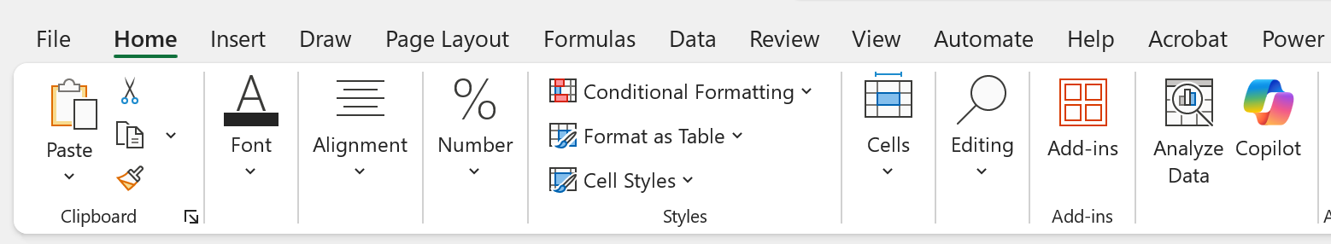
Pulse Check
Do you have access to Copilot in Excel?
Home > Copilot

Slide 5
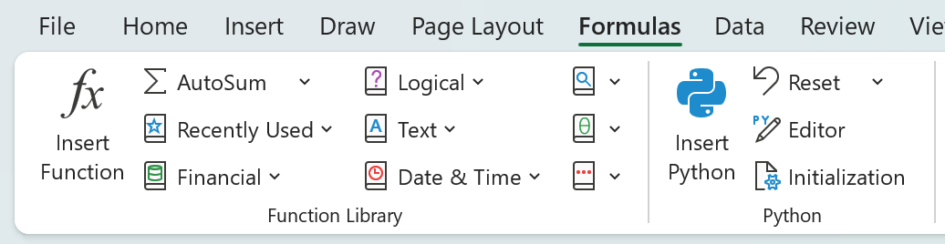
Pulse Check
Do you have access to Python in Excel?
Formulas > Python

Slide 6
I. Excel Essentials for AI
What Excel features does Python in Excel depend on?
Data import with Power Query
Data preview with linked data types
Structured references with Excel tables
Mixing Python and Excel operations with dynamic arrays
Creating, resizing, and referencing Python plots with images in cells
Demo file: python-in-excel-features-demo.xlsx

Slide 7
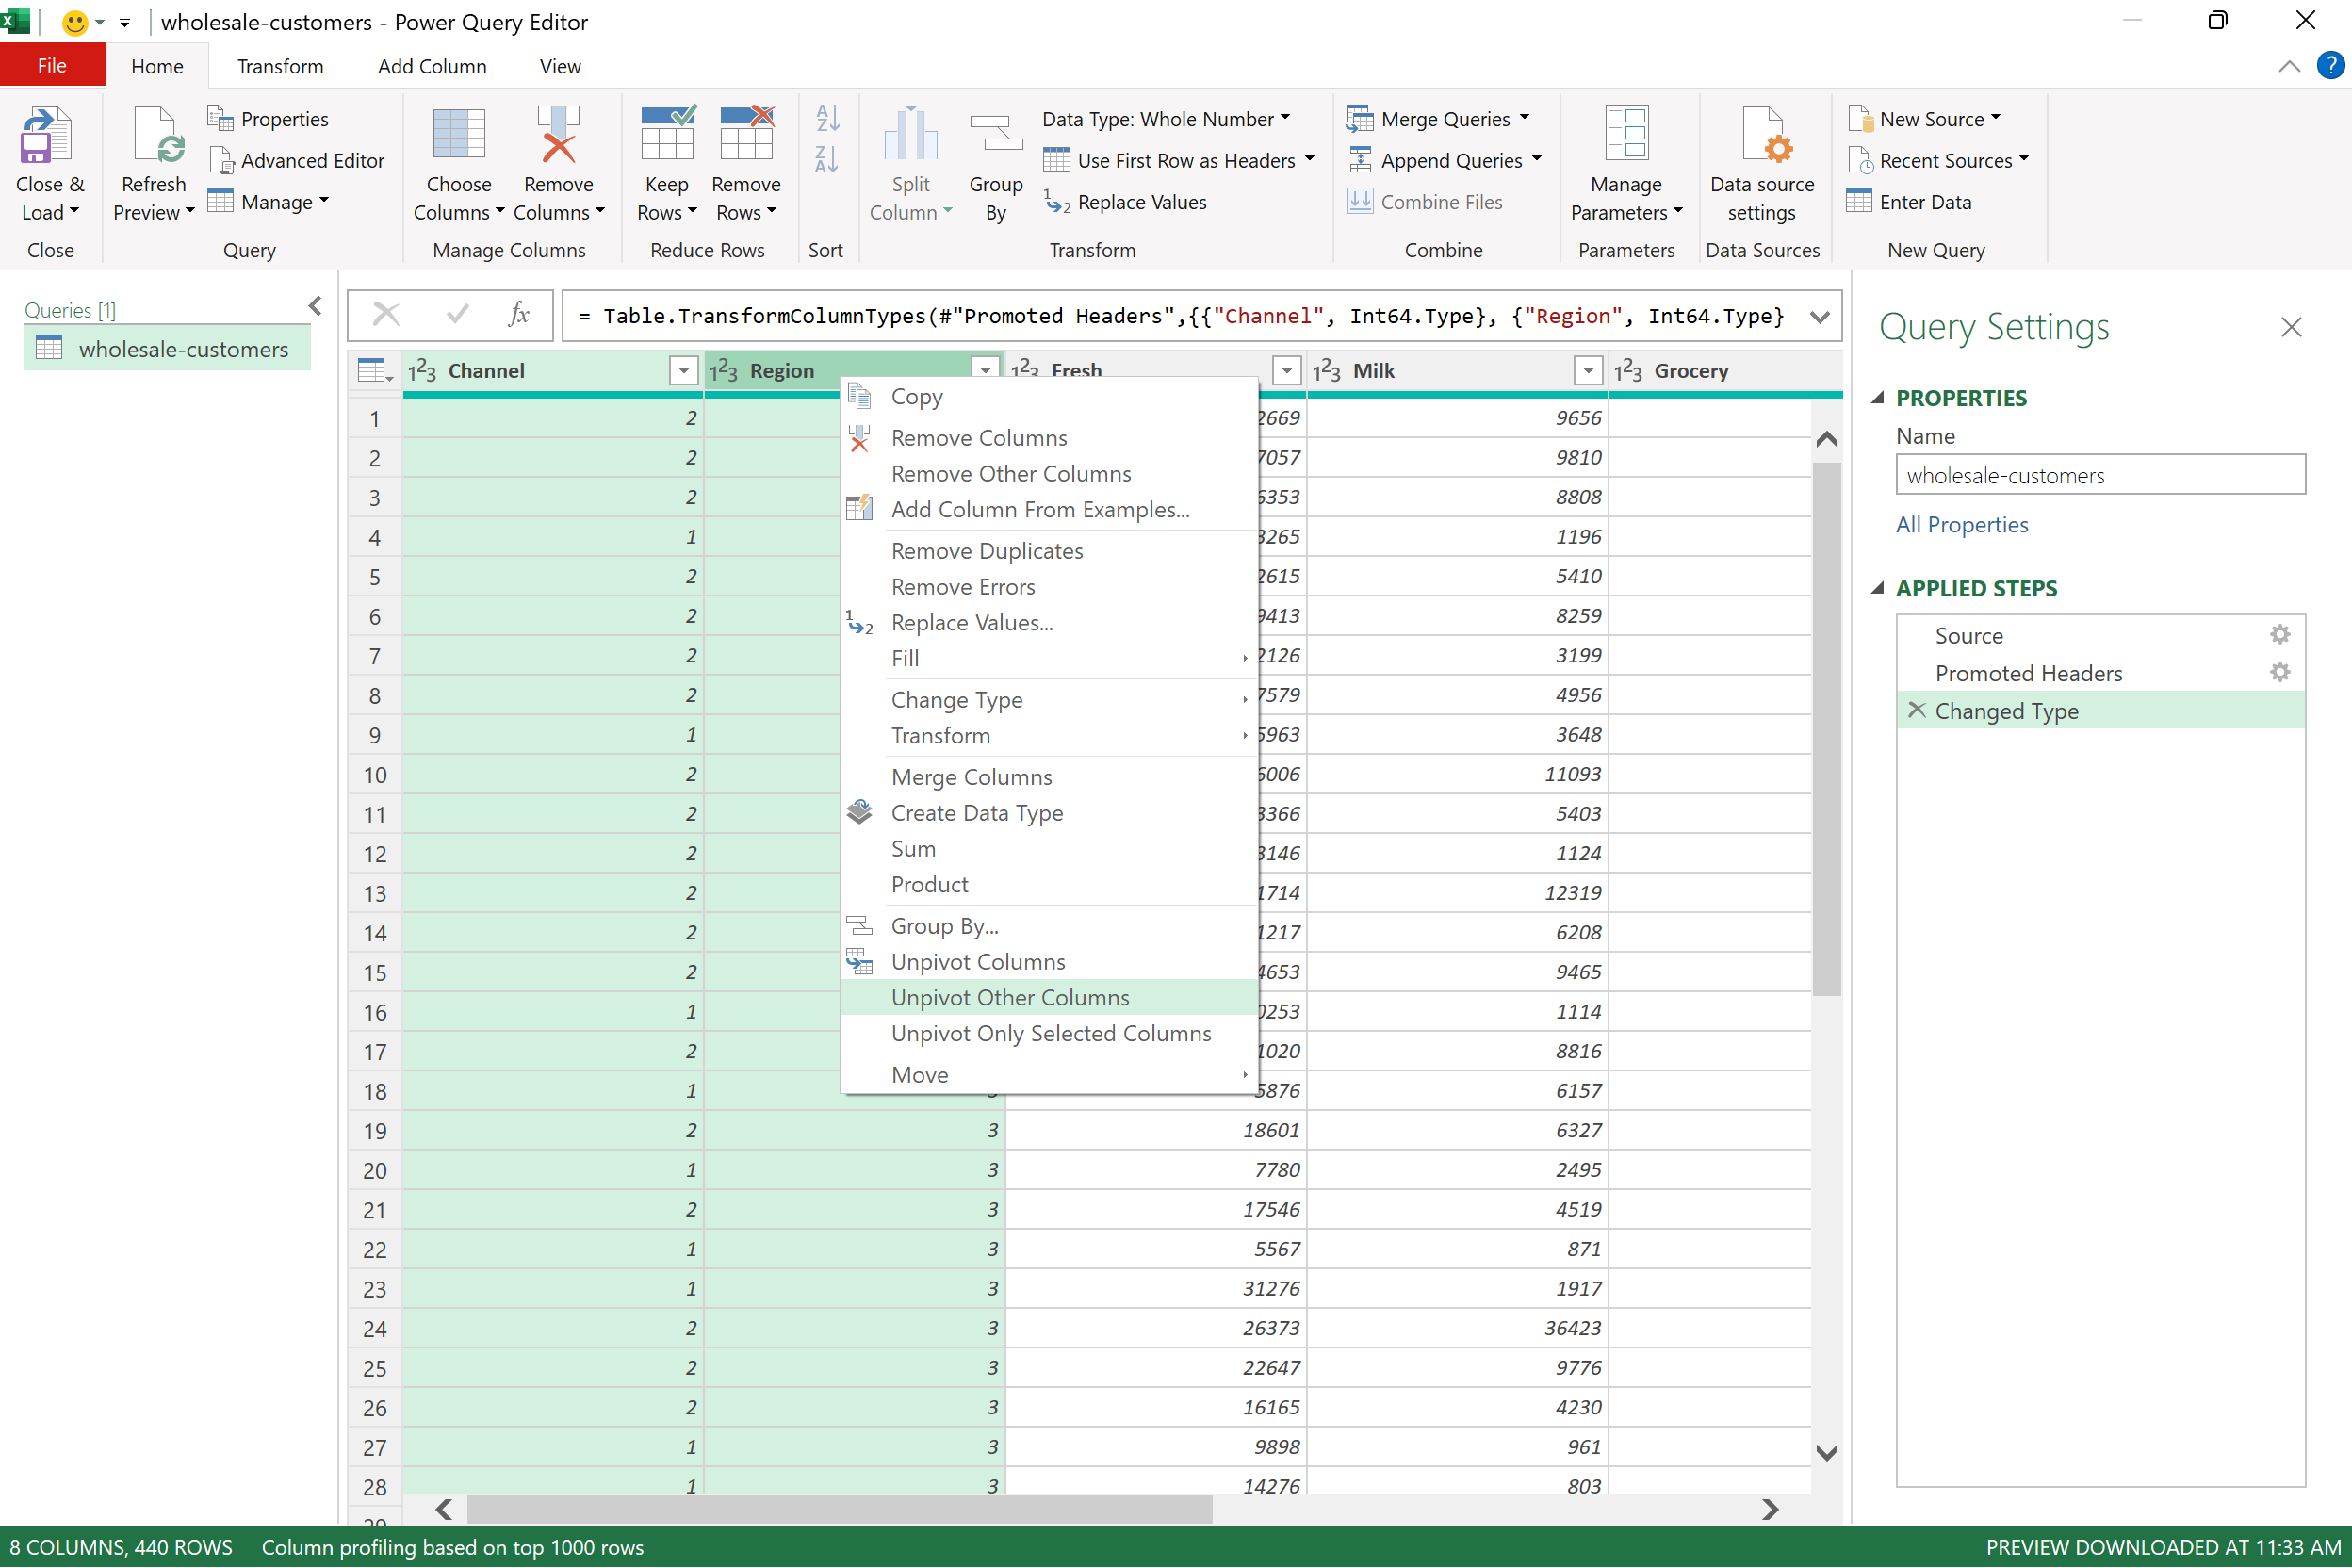
Exercise
Import & transform Wholesale Customers for Python in Excel
Dataset: wholesale-customers.csv
Import into Excel via Power Query (Get Data > From File > From Text/CSV)
Unpivot the Fresh through Delicassen [sic] columns
Load as connection into Python in Excel
Preview the data with a linked data type
Count the number of nonblank cells in the preview area with a spill operator
Notes:
The key to #2 is using “Unpivot All” in Power Query. If you're not sure how to do this, feel free to skip it and just load the data into Excel for now. But take this as a sign—it might be worth brushing up a bit on Power Query before diving deeper into Python in Excel!

Slide 8
II. Introduction to Copilot in Excel
Getting started with Advanced Analysis
Loading dataset into “Advanced Analysis”
Conducting a guided step-by-step analysis with Python and Copilot
Diving deeper by questoning Copilot’s reasoning and asking for follow-up explanations and support
Demo file: ai-powered-python-excel-getting-started.xlsx

Slide 9
Discussion Question
Identify a data analytics task that you believe could be automated or assisted using Copilot. How could this change your workflow?
Notes:
Could help you create charts or summaries quickly, or maybe it could even help you take your analysis one level deeper with predictive analytics, unstructured data or charts that are otherwise difficult to build in Excel

Slide 10
Questions?
Notes:
You will be able to see questions as they come in. Some instructors like to include this slide as a visual reminder to check the Q&A widget, but it’s not required.

Slide 11
Break
Notes:
Breaks are flexible in On24. At the end of your deck you’ll have 5 minute, 7 minute, 10 minute, and 15 minute timers that you will be able to push to the audience whenever you want. Some presenters like to include this break slide as a visual reminder, but it’s not required.

Slide 12
III. PivotTables and Data Visualization
Creating PivotTables and data summaries with Copilot
Work around Copilot’s limitations with PivotTables and GROUPBY() / PIVOTBY() functions
Enhance your analysis with Copilot by adding totals, percentages, and custom ad-hoc calculations
Demo file: copilot-pivottables-demo.xlsx

Slide 13
III. PivotTables and Data Visualization
Creating advanced data visualizations with Copilot
Generate advanced visualizations not natively available in Excel, such as stripplots, pairplots, jointplots, and small multiples
Combine multiple visual elements in a single chart to enhance insight and clarity
Recognize the value of combining technical skills with strategic thinking for effective data storytelling
Demo file: copilot-dataviz-demo.xlsx

Slide 14
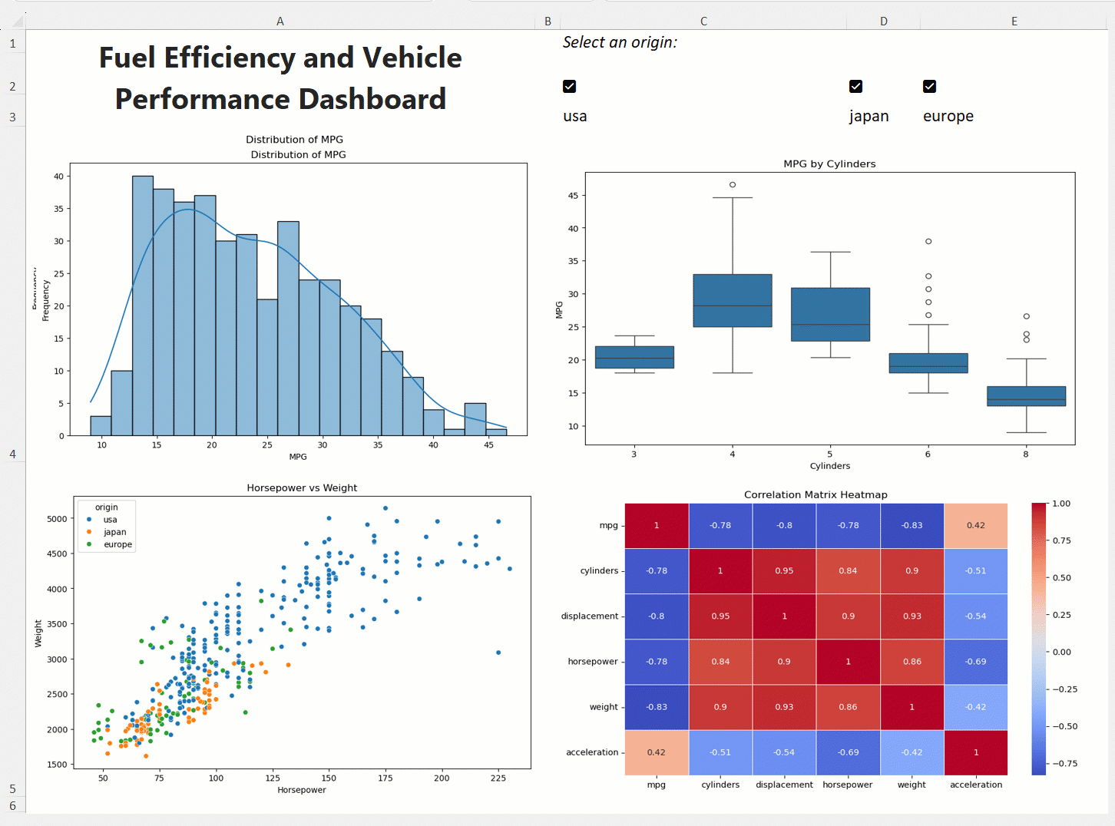
Exercise
Create a dashboard with Copilot
Dataset: copilot-dashboard-start.xlsx
Use Advanced Analysis to create visualizations for a dashboard
Check mpg-dashboard-prompt.txt for a sample input prompt
We’ll walk through assembling the dashboard together
Your results will vary from mine… embrace it!
Notes:
The key to #2 is using “Unpivot All” in Power Query. If you're not sure how to do this, feel free to skip it and just load the data into Excel for now. But take this as a sign—it might be worth brushing up a bit on Power Query before diving deeper into Python in Excel!

Slide 15
Questions?
Notes:
You will be able to see questions as they come in. Some instructors like to include this slide as a visual reminder to check the Q&A widget, but it’s not required.

Slide 16
Break
Notes:
Breaks are flexible in On24. At the end of your deck you’ll have 5 minute, 7 minute, 10 minute, and 15 minute timers that you will be able to push to the audience whenever you want. Some presenters like to include this break slide as a visual reminder, but it’s not required.

Slide 17
IV. Time Series and Text Analysis
Time series analysis with Copilot
Resample time series data by aggregating daily sales into monthly or quarterly totals
Perform diagnostic checks such as testing for stationarity to prepare data for forecasting
Build an ARIMA model and evaluate its accuracy using visualizations and Copilot-assisted insights
Demo file: copilot-time-series-demo.xlsx

Slide 18
IV. Time Series and Text Analysis
Regular Expressions with Copilot
Regex = patterns used to match and manipulate text based on specific rules and symbols
Excel now has regex functions…
… but Copilot prefers returning them in Python!
Identify and strip email domains, credit card numbers, PII, etc.
Demo file: copilot-regex-demo.xlsx

Slide 19
IV. Time Series and Text Analysis
Text analysis with Copilot
Explore basic text analysis visualizations (e.g. word clouds, frequency charts)
Build a predictive model to classify review sentiments
Evaluate the strengths and limitations of text analysis techniques like word clouds and sentiment prediction.
Demo file: copilot-text-demo.xlsx

Slide 20
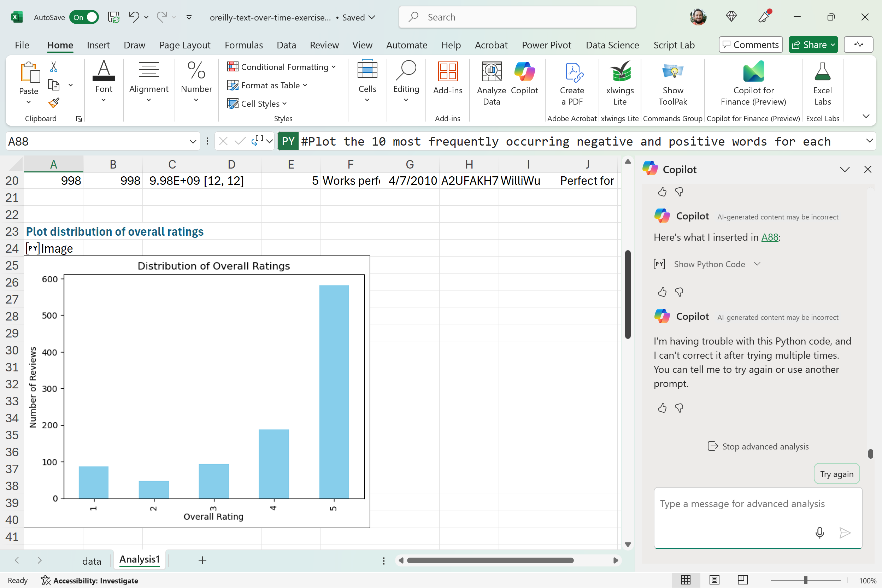
Exercise
Tracking customer reviews over time
Dataset: copilot-text-time-series-exercise.xlsx
Analyze customer reviews across different time periods using this dataset
Use Copilot to visualize the top positive and negative sentiment words for each quarter
Ask Copilot to explain the strengths and limitations of this type of sentiment analysis.

Slide 21
Questions?
Notes:
You will be able to see questions as they come in. Some instructors like to include this slide as a visual reminder to check the Q&A widget, but it’s not required.

Slide 22
V. Wrap-up and Q&A
Techniques for validating and cross-checking AI-generated insights in Excel
Key takeaways and lessons from today's session
Recommended resources & next steps

Slide 23
Key Takeaways For Today
AI-powered Python in Excel is designed for experienced users, not beginners
Human analysts remain essential for oversight and interpretation
How could this shift reshape the future of data analytics?
Is this the beginning of the end for dashboard-centric “self-service BI”?
The rise of augmented analytics and the “citizen data scientist”

Slide 24

Cross-checking AI-powered Excel
What processes can we follow to safeguard and cross-check our Python-Copilot-Excel workflow?
Resource: https://stringfestanalytics.com/how-to-cross-check-ai-generated-insights-in-excel/
“Treat AI like an intern”

Slide 25
Recommended Resources
Available on O’Reilly Online Learning:
Read Python for Excel: A Modern Environment for Automation and Data Analysis (book)
Attend Write Python Code with ChatGPT and Claude (live online course by Trey Hunner)
Attend Generative AI Essentials with ChatGPT, Copilot, and Gemini (live online course by Aamir Lakhani)

Slide 26
Takeaways
Get in touch
stringfestanalytics.com: Subscribe for more content and updates
Check ai-powered-python-in-excel-resources.docx in your resource folder for a series of curated posts on this topic
linkedin.com/in/gjmount: Follow for all things analytics in modern Excel

Slide 27
Takeaways
Next steps
A quick survey will appear on your screen soon… we’d love to hear your thoughts
You’ll receive a recording via email within 24-48 hours.
Thanks so much for joining -- hope to see you at future events!

Slide 28
Q&A
Notes:
You will be able to see questions as they come in. Some instructors like to include this slide as a visual reminder to check the Q&A widget, but it’s not required.

Slide 29


Slide 30
Poll: What will you ask attendees?
Polls are a great way to check in with attendees! You can ask them about their opinions, experience level, or quiz their knowledge. We find that 1-3 poll questions per hour is best.
Poll answer 1
Poll answer 2
Poll answer 3

Slide 31
Discussion Question
What should attendees think about? Ask a prompt question that attendees can answer in the group chat.

